Slide 1
Naming, Scoping, Binding
COP 4020
Pete Dobbins

Slide 2
Vocabulary
A name is exactly what you think it is
Most names are identifiers
Sometimes, symbols [like ‘+’] can also be names
A binding is an association between two things, such as a name and the thing that it names.
The scope of a binding is the part of the program [textually] in which the binding is active.

Slide 3
Vocabulary
Binding Time
The point at which a binding is created,
Or, more generally, the point at which any implementation decision is made

Slide 4
Binding Time Examples
Language Design Time
Program structure
Primitive types
Language Implementation Time
I/O
Number of bits in primitive types
How arithmetic overflow is handled
Type equality
Java attempts to define more at language design time than most languages for portability.
Fixing decisions at language design time may disallow architecture specific optimization.

Slide 5
Binding Time Examples
Program Writing Time
Algorithms
Names
Compile Time
Plan for data layout
Link Writing Time
Layout of the whole program in memory
Load Time
Choice of physical address

Slide 6
Binding Time Examples
Run Time
Value bindings
Variable bindings
Size of strings
Run Time Subsumes
Program start-up time
Module entry time
Elaboration time [point at which a declaration is first “seen”]
Procedure entry time
Block entry time
Statement execution time

Slide 7
Static vs Dynamic
Static refers to things
bound before run time.
Dynamic refers to things
bound at run time.

Slide 8
Early vs Late Binding
Early Binding Times
Usually associated with greater efficiency
Compiled languages tend to have early binding times
Later Binding Times
Associated with greater flexibility
Interpreted languages tend to have later binding times

Slide 9
Object Lifetime and Storage Management
Important: distinguish between names and the objects to which they refer.
Key Events
Creation of objects
Creation of bindings
Reference to objects using the bindings
[temporary] Deactivation of bindings
Reactivation of bindings
Destruction of bindings
Destruction of objects

Slide 10
Object Lifetime and Storage Management
Important: distinguish between names and the objects to which they refer.
Key Events
Creation of objects
Creation of bindings
Reference to objects using the bindings
[temporary] Deactivation of bindings
Reactivation of bindings
Destruction of bindings
Destruction of objects
In this discussion, object refers to anything being bound to a name: classes, variables, types, and so on.
It is not necessarily an object as the term is used in OOP.

Slide 11
Lifetime and Scope
The scope of a binding is the region of the program in which the binding is active.
Lifetime
The period of time from binding creation to destruction.
If an object outlives its binding, it is garbage.
c1
c2
class Circle extends Shape implements Comparable {
// …
}
Comparable c1, c2;
c2 = new Circle(5);
0xFFFF0001
Circle
radius: 5

Slide 12
Lifetime and Scope
The scope of a binding is the region of the program in which the binding is active.
Lifetime
The period of time from binding creation to destruction.
If an object outlives its binding, it is garbage.
c1
class Circle extends Shape implements Comparable {
// …
}
Comparable c1, c2;
c2 = new Circle(5);
0xFFFF0001
Exit c2’s scope
Circle
radius: 5

Slide 13
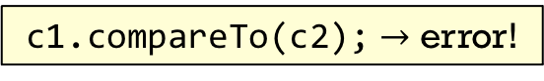
Lifetime and Scope
The scope of a binding is the region of the program in which the binding is active.
Lifetime
The period of time from binding creation to destruction.
If an object outlives its binding, it is garbage.
If a binding outlives the bound object, it is a dangling reference.
c1
c2
class Circle extends Shape implements Comparable {
// …
}
Comparable c1 = new Circle(3);
Comparable c2 = c1;
?
free(0xFFFF0001)
c1.compareTo(c2); $→$ error!

Slide 14
Storage Allocation
Object lifetimes are associated with storage allocation mechanisms.
Static: an object is given an address that is maintained through program execution.
Stack: memory for objects is allocated in last-in, first-out (LIFO) order, usually in conjunction with subroutine calls and returns.
Heap: memory for objects is allocated in a region of memory where sub-blocks can be allocated and deallocated at arbitrary times.

Slide 15
Static Allocation Usage
Static Allocation is typically used for:
Code
Globals
Static variables
Explicit constants [strings, sets, etc.]
Scalars stored in instructions

Slide 16
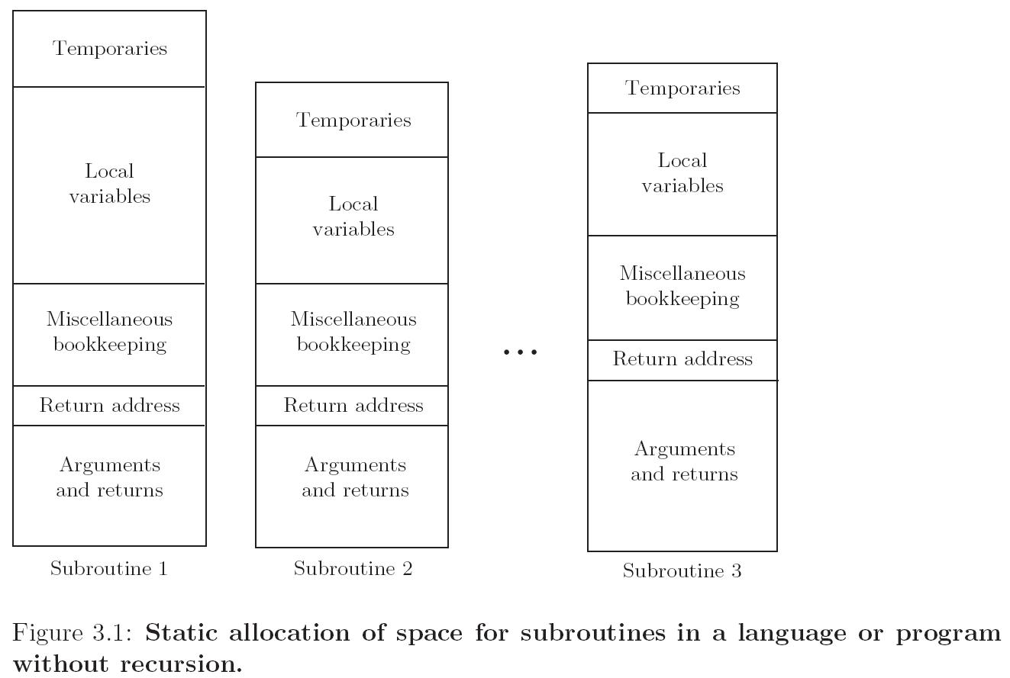
Static Allocation for a Language without Recursion
Scott Figure

Slide 17
Stack Allocation
Why use a Stack?
Works for recursive routines
Allows reuse of space
Relevant to all languages
Space only allocated for active routines
Although location of stack cannot be predicted at compile time, offsets of objects in stack relative to the stack frame can be determined statically
Stack Allocation is typically used for:
Parameters of procedures
Local variables
Temporaries
[e.g., intermediate values of expressions]

Slide 18
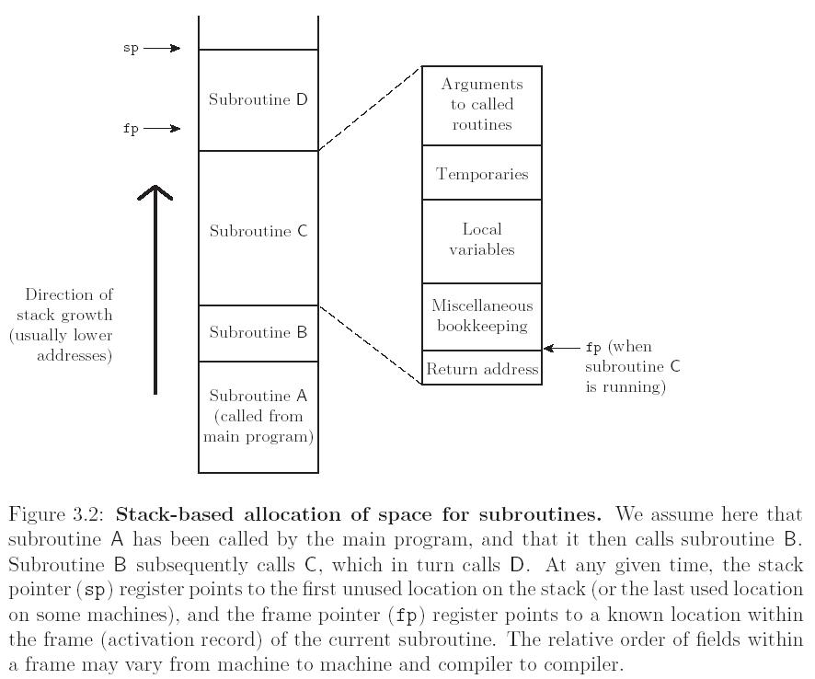
Stack Allocation
Scott Figure

Slide 19
Heap-based Allocation
Memory for an object is allocated in a region of memory where sub-blocks can be allocated and deallocated at arbitrary times.
Tradeoffs between:
Space
Allocation Speed

Slide 20
Heap-based Allocation
Space
Internal fragmentation: memory blocks are larger than needed, unused space is allocated [wasted]
External fragmentation: memory is available, but in small non- contiguous pieces
Memory for an object is allocated in a region of memory where sub-blocks can be allocated and deallocated at arbitrary times.
Tradeoffs between:
Space
Allocation Speed
Various approaches exist with various time, space tradeoffs.
Allocation Speed
With more computation, can reduce fragmentation

Slide 21
Heap Allocation and Deallocation
Allocation: occurs at a specific point in program
New objects are instantiated
Long string assigned to previously shorter string
And so on…
Deallocation:
Explicit: when indicated by programmer [C, C++]
Implicit:
on exiting scope
garbage collection occurs sometime after no more references to an object exist

Slide 22
RAII: Resource Allocation is Initialization
C++ idiom to manage resources, including heap memory, threads, sockets, open file, locked mutex, disk space, db connection, etc.
AKA Scope-Bound Resource Management (SBRM).
Binds life cycle of a resource that must be acquired before use to the lifetime of the object.
Resource is available to any functions that can access the object.
Resource is released at end of lifetime of controlling object.
Avoids resource leaks and guarantees exception safety.

Slide 23
RAII: Implementation
Encapsulate resource in a class where:
Constructor acquires resource and establishes class invariants or throws an exception.
Destructor releases the resource and never throws exceptions.
Use the resource via an instance of an RAII-class that has “automatic storage or temporary lifetime”.

Slide 24
RAII: Example
mem::mem(size_t size) {
if ( size > 0 )
data = new char[size];
};
class mem {
public:
mem(size_t size);
~mem();
char * data;
char * getData();
// …
};
mem::~mem() {
delete [] data;
};

Slide 25
RAII: Example
class mem {
public:
mem(size_t size);
~mem();
char * data;
char * getData();
// …
};
Usage {
// …
mem dbrec(n);
f( dbrec.getData() );
// …
};

Slide 26
Tradeoffs
Explicit
Simpler compiler implementation
Better execution speed
Subject to dangling references due to programmer error
deallocation bugs are common and serious in practice.
Subject to memory leaks where unused memory is never deallocated
this can cause programs to eventually run out of heap space.
Implicit
Simplifies programming task
with garbage collection dangling references cannot occur.
Fewer memory leaks
but these may still occur if the programmer keeps references to unneeded objects.
High quality garbage collection algorithms are available, and technology is improving.

Slide 27
Scope
Recall: the scope of a binding is the part of the program [textually] in which the binding is active.
Scope [more precisely]
A program section of maximal size in which no bindings change [or at least in which no re-declarations are permitted.]

Slide 28
Scope
Referencing Environment: set of active bindings at some point in program execution.
Scope Rules: define referencing environment.
Elaboration:
The process of creating bindings when entering a scope.
First used with Algol 60, Ada re-popularized the term.
Storage may be allocated, tasks started, even exceptions propagated as a result of the elaboration of declarations.

Slide 29
Example: Subroutines [in most languages]
On Subroutine Entry – enter a new scope:
Create bindings for new local variables.
Deactivate bindings for global variables that are re-declared [these variables are said to have a “hole” in their scope.]
Make references to variables.
On Subroutine Exit:
Destroy bindings for local variables.
Reactivate bindings for global variables that were deactivated.

Slide 30
Static vs Dynamic Scoping
Statically [lexically] Scoped – scope of a binding is determined by lexical structure of the program:
The determination of scopes can be made by the compiler.
All bindings for identifiers can be resolved by examining the program.
Typically, we choose the most recent, active binding made at compile time.
Most compiled languages employ static stope rules.
Dynamically Scoped: scope of a binding is determined at runtime [and depends on flow of execution.]

Slide 31
Classic Example of Static Scope
Used in block structured languages such as Algol 60 and Pascal.
These languages allow nested subroutines.
Most closely nested rule:
An identifier is known in the scope in which it is declared and in each enclosed scope, unless it is re-declared in an enclosed scope.
To resolve a reference to an identifier, we examine the local scope and statically enclosing scopes until a binding is found.

Slide 32
Example Code
Code |  |  |  | Comment
program example |  |  |  | block: example
 | var a, b: int
 | procedure sub1; var x, y: int |  |  | block: sub1 (in example)
 | begin {sub1}
 |  | …
 | end {sub1}
 | procedure sub2; var x: int |  |  | block: sub2 (in example)
 |  | …
 |  | procedure sub3; var x: int |  | block: sub3 (in sub2)
 |  | begin {sub3}
 |  |  | x = …
 |  | end {sub3}
 | begin {sub2} |  |  | block: sub2
 |  | …
 | end {sub2}
begin {example} |  |  |  | block: example
 | …
end {example}

Slide 33
Implementation of Variable Access
Most-closely Nested Rule: use static links
Each frame points to the frame of the [correct instance of] the routine inside which it was declared.
In the absence of subroutines passed as a parameter, correct means closest to the top of the stack.
Accessing a variable in scope k levels out, by following k static links and then using the known offset within the frame found.

Slide 34
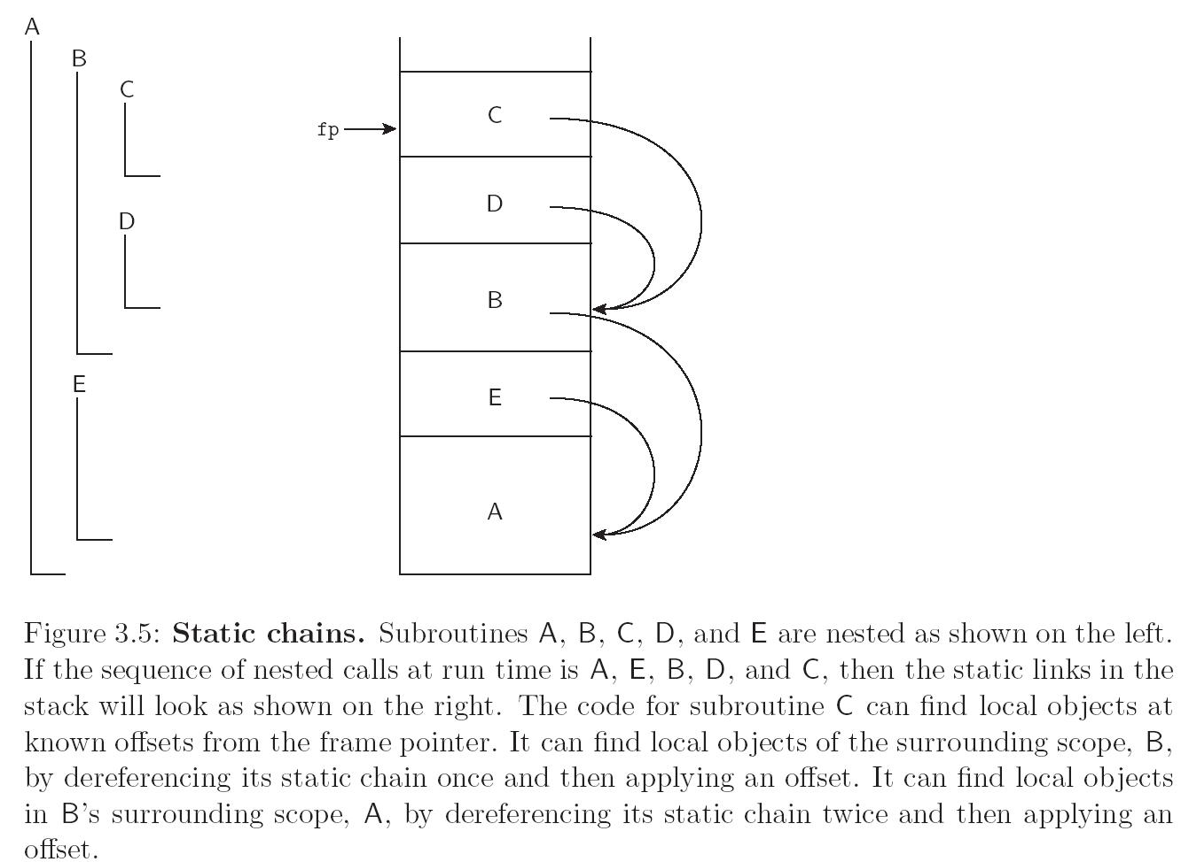
Scope Rules
Scott Figure

Slide 35
More Example of Static Scope
Basic: one global scope
Traditional [e.g., Fortran]:
Global variables visible everywhere.
Local variables are only visible in a subroutine where they appear.
By default, lifetime of local variables and their bindings is the extent of the subroutine execution.
Can override this using the save statement to make the lifetime of a variable the entire execution of the program. Thus, the variable retains its value between calls, but the binding is only active inside the subroutine.

Slide 36
Fortran-like Example
subroutine f()
save int i;
i = i + 1;
print i;
end f;
f() // prints 1
print i // error, i not visible
// however, note i does exist
f() // prints 2
f() // prints 3

Slide 37
Nested Blocks
In some languages, blocks determine a scop and may be declared anywhere [not just to define the statements of a subroutine].
Java, C, C++:
{}s delineate scope
Scopes are nested, but subroutines are not.

Slide 38
Declaration Order
Is a declaration in a scope:
Valid in the entire scope?
Or just in the text following the definition?
If a name must be declared before use, then how can we allow recursive types and subroutines: different languages deal with this in different ways.

Slide 39
Pascal
Forward references for procedures:
Give the signature [name, parameters, return type] first. Enough information to compile a call to the procedure.
Later, the complete definition is provided.
Treat pointers as a special case in type definitions. Only pointers can be used recursively in type definitions.
ListPtr = POINTER to ListNode
ListNode = Record
data: …
next: ListPtr
END
What is so special about pointers?

Slide 40
Pointers
Languages in General:
Pointers always have the same size.
Regardless of what they point to.
So they can be handled as a special case.
Pascal: forward references for procedures plus limiting recursion in types to pointers enables one-pass compilation.

Slide 41
C, C++
Differentiate:
Declaration – introduces name and defines scope.
Definition – introduces object to which the name is bound.
struct manager; // declaration
struct employee { // sample usage
struct manager *boss;
struct employee *next;
}
struct manager { // definition
struct employee *first;
…
}

Slide 42
Scopes and “Programming in the Large”
Large software projects require work to be done by multiple programmers who can work simultaneously.
Need language support for information hiding – making details invisible to parts of the system that do not need them.
Reduces cognitive load on programmers.
Reduces risk of naming conflicts.
Helps protect integrity of data abstractions [can limit with support from compiler, access to internals of abstraction.]
Implies the need to decouple object lifetime from visibility.

Slide 43
Decoupling Lifetime from Visibility
Allow local variables of a subroutine to keep their value between calls.
For example: static variables in C and saved variables in Fortran.
Lifetime longer than subroutine invocation.
Variables are visible only in subroutine.
Disadvantage:
Only allows single subroutine abstraction.
For example, unable to create the straightforward implementation of a stack with multiple operations implemented by different subroutines.

Slide 44
Modules – [package, cluster, namespace]
Encapsulates collection of objects [variables, subroutines, types, etc] so that:
Objects inside module are visible to each other.
Objects inside module are not visible outside unless exported.
[in many languages] Objects outside are not visible inside the module unless explicitly imported.
Object lifetime is orthogonal to visibility.
For Example,
Modula-2, designed by Niklaus With to improve upon Pascal
Supports local modules and global modules

Slide 45
Modula-2: Local Modules
Code |  |  |  | Comment
VAR a, b: INTEGER: |  |  |  | global
 | MODULE M; |  |  | M
 |  | IMPORT a; EXPORT w, x;
 |  | VAR u, v, w: INTEGER;
 |  | MODULE N; |  | N
 |  |  | IMPORT u; EXPORT x, y;
 |  |  | VAR x, y, z: INTEGER
 |  |  | (* u, x, y, z visible *)
 |  | END N;
 |  | (* a, u, w, x, y visible *)
 | END M;
 | (* a, b, w, x visible *)
END

Slide 46
Modula-2: Local Modules
Local modules are an obvious next step from nested subroutines. In practice not found to be very useful.
Code |  |  |  | Comment
VAR a, b: INTEGER: |  |  |  | global
 | MODULE M; |  |  | M
 |  | IMPORT a; EXPORT w, x;
 |  | VAR u, v, w: INTEGER;
 |  | MODULE N; |  | N
 |  |  | IMPORT u; EXPORT x, y;
 |  |  | VAR x, y, z: INTEGER
 |  |  | (* u, x, y, z visible *)
 |  | END N;
 |  | (* a, u, w, x, y visible *)
 | END M;
 | (* a, b, w, x visible *)
END

Slide 47
Global Modules in Modula-2
Divide a module in two parts: DEFINITION and IMPLEMENTATION
The two modules are in separate files.
A client module needs only the compiled definition module, thus the module internals are hidden.
DEFINITION MODULE
Define the module’s interface
Contains all information needed to compile a module that uses it [exported names, types, and so on]
IMPLEMENTATION MODULE
Defines internals

Slide 48
Everything in the Definition Module Exported
DEFINITION MODULE Buffer;
VAR nonempty, nonfull: BOOLEAN;
PROCEDURE put( x: INTEGER );
PROCEDURE get( VAR x: INTEGER );
END Buffer.

Slide 49
Implementation Module
IMPLEMENTATION MODULE Buffer;
CONST N = 100;
VAR in, out [0..N-1];
N: [0..N];
buf: ARRAY[0..N-1] of INTEGER;
PROCEDURE put(x: INTEGER);
BEGIN
IF n < N THEN
buf[in] := x; in := (in + 1) MOD N;
n := n + 1; nonfull := n < N; nonempty := TRUE;
END
END put;

Slide 50
Implementation Module
PROCEDURE get(VAR x: INTEGER);
…
END get;
BEGIN (*initialize*)
n := 0; in := 0; out := 0;
nonempty := FALSE; nonfull := TRUE;
END BUFFER.

Slide 51
Test Code
MODULE MainBufferClient;
IMPORT Buffer;
…
BEGIN
…
Buffer.put(item);
(* if no name conflicts, just use: put(item) *)
…
END MainBufferClient.

Slide 52
Consider…
Question: How many instances can there be of a module?
Note from the previous slide, the Buffer was not explicitly instantiated.
In Modula-2 [and often in languages with modules] only 1 instance.
If a program needs 2 buffers, then we need a module for each of them.
For example, create MODULE Buffer2 and replicate the code.

Slide 53
A Workaround…
Use the module as a manager of a type, rather than the type itself.
The former module [i.e. Buffer] become a record [or type] in the new module.
Variables become fields of the record.
Procedures accept the record as a parameter.

Slide 54
Version 2 of the Buffer Solution
DEFINITION MODULE BufferManager;
CONST N = 100;
TYPE Buffer = RECORD
VAR in, out [0..N-1];
n: [0..N];
buf: ARRAY[0..N-1] of INTEGER;
END
PROCEDURE put(VAR b: BUFFER; X: INTEGER)
PROCEDURE get(VAR b: BUFFER; VAR x: INTEGER)
PROCEDURE init(VAR b: BUFFER)
END BufferManager.

Slide 55
Version 2 of the Buffer Solution
DEFINITION MODULE BufferManager;
CONST N = 100;
TYPE Buffer = RECORD
VAR in, out [0..N-1];
n: [0..N];
buf: ARRAY[0..N-1] of INTEGER;
END
PROCEDURE put(VAR b: BUFFER; X: INTEGER)
PROCEDURE get(VAR b: BUFFER; VAR x: INTEGER)
PROCEDURE init(VAR b: BUFFER)
END BufferManager.
It is also possible to hide the implementation of the Buffer by exporting an opaque POINTER to the buffer instead of the buffer itself.

Slide 56
Version 2 of the Buffer Solution
IMPLEMENTATION MODULE BufferManager;
PROCEDURE put(VAR b: BUFFER; X: INTEGER)
BEGIN
IF n < N THEN
b.buf[in] := x; b.in := (b.in + 1) MOD b.N;
b.n := b.n + 1;
END
END put;

Slide 57
Version 2 of the Buffer Solution
IMPLEMENTATION MODULE BufferManager;
PROCEDURE get(VAR b: BUFFER; VAR x: INTEGER)
BEGIN
…
END get;
PROCEDURE init(VAR b: BUFFER)
BEGIN
…
ENG init;
END BufferManager.

Slide 58
Version 2 of the Buffer Solution
IMPLEMENTATION MODULE BufferManager;
PROCEDURE get(VAR b: BUFFER; VAR x: INTEGER)
PROCEDURE init(VAR b: BUFFER)
END BufferManager.

Slide 59
Test Code
MODULE MainBufferClient;
IMPORT BufferManager;
…
b: BufferManager.Buffer;
BEGIN
b = NEW(BufferManager.Buffer);
BufferManager.init(b);
…
BufferManager.put(b,item);
END
END MainBufferClient.

Slide 60
Classes
Similar to modules, except they statically bind procedures to a type.
For example, imagine a new version of Modula + Classes (similar to Oberon 2).

Slide 61
Revised DEFINITION MODULE
DEFINITION MODULE BufferManager;
TYPE Buffer = RECORD
CONST N = 100;
VAR in, out [0..N-1];
n: [0..N];
buf: ARRAY[0..N-1] of INTEGER;
PROCEDURE put(VAR b: BUFFER; X: INTEGER)
PROCEDURE get(VAR b: BUFFER; VAR x: INTEGER)
PROCEDURE init(VAR b: BUFFER)
END (* of type Buffer *)
END BufferManager.
Now the methods are defined inside of the record.

Slide 62
Classes
Inside the implementation module, use a keyword to refer to this implicit argument: often self or this.
In a client program that imports the modified BufferManager and declares a variable b of type Buffer:
say b.put(x);
Rather than BufferManager.put(b, x);
Classes also include inheritance and other concepts that we have already discussed and will continue to examine as we consider OOP.

Slide 63
Additional Support for “Programming in the Large”
Independent Compilation
Can compile different parts of a program independently, but no type checking across the compilation units.
Separate Compilation
Can compile different parts of a program independently, with type checking across the compilation units.
Extremely important in maintaining large systems.

Slide 64
Example: Separate Compilation in Modula-2
The definition module contains the information needed by clients.
During development, write the definition module first and compile it to produce a symbol file.
With the symbol file, clients can compile their code to generate an object file.
If the symbol file does not change, the implementation module can change without requiring recompilation of clients.
The clients can work with a “stub” implementation.

Slide 65
Linking

Slide 66
Maintaining Consistency
Each symbol file is given a key.
Each object file includes the keys of all symbol files for imported modules.
Keys are matched by the linker.
Possible approaches for obtaining keys:
Timestamps
Signature or Checksum
TIMESTAMPS
Advantage: simple
Disadvantage: merely recompiling definition module without changing it requires all clients to be recompiled
SIGNATURE | CHECKSUM
depends only on content
still fragile – reordering declarations changes key

Slide 67
Oberon, Successor to Modula-2
Another Niklaus Wirth language.
Most important new concept: type extensions [inheritance].
Instead of writing explicit definition module the programmer marks items to be exported.
The definition module is thus implicit.
The symbol file is generated from marked items.
The symbol file only changes when exported items change.
There are traps for the unwary… for example, changing the declaration order changes the symbol file.

Slide 68
Java
Java has more sophisticated encapsulation concepts than Modula-2 and Oberon.
Classes may belong to a package.
Accessibility constraints: public, protected, default, private, and local variables.
Symbol file information is extracted from class files by the compiler.
Class files contain symbolic names.
Compatibility checks are performed as part of byte code verification.

Slide 69
Dynamic Scope
The current binding is the one [the binding] encountered most recently during program execution.
A few languages with dynamic scope: APL, Lisp, Perl.

Slide 70
Which is it?
x: integer;
procedure sub1 { print x; }
procedure sub2 {
x: integer;
x = 100;
call sub1;
}
read x;
if ( x > 0 ) call sub1 else call sub2;
Which x does this refer to???

Slide 71
Dynamic Scope
x: integer;
procedure sub1 { print x; }
procedure sub2 {
x: integer;
x = 100;
call sub1;
}
read x;
if ( x > 0 ) call sub1 else call sub2;
Dynamic Scope
if x > 0 then print input read
else if x <= 0 then print 100

Slide 72
Static Scope
x: integer;
procedure sub1 { print x; }
procedure sub2 {
x: integer;
x = 100;
call sub1;
}
read x;
if ( x > 0 ) call sub1 else call sub2;
Static Scope
Always print input read

Slide 73
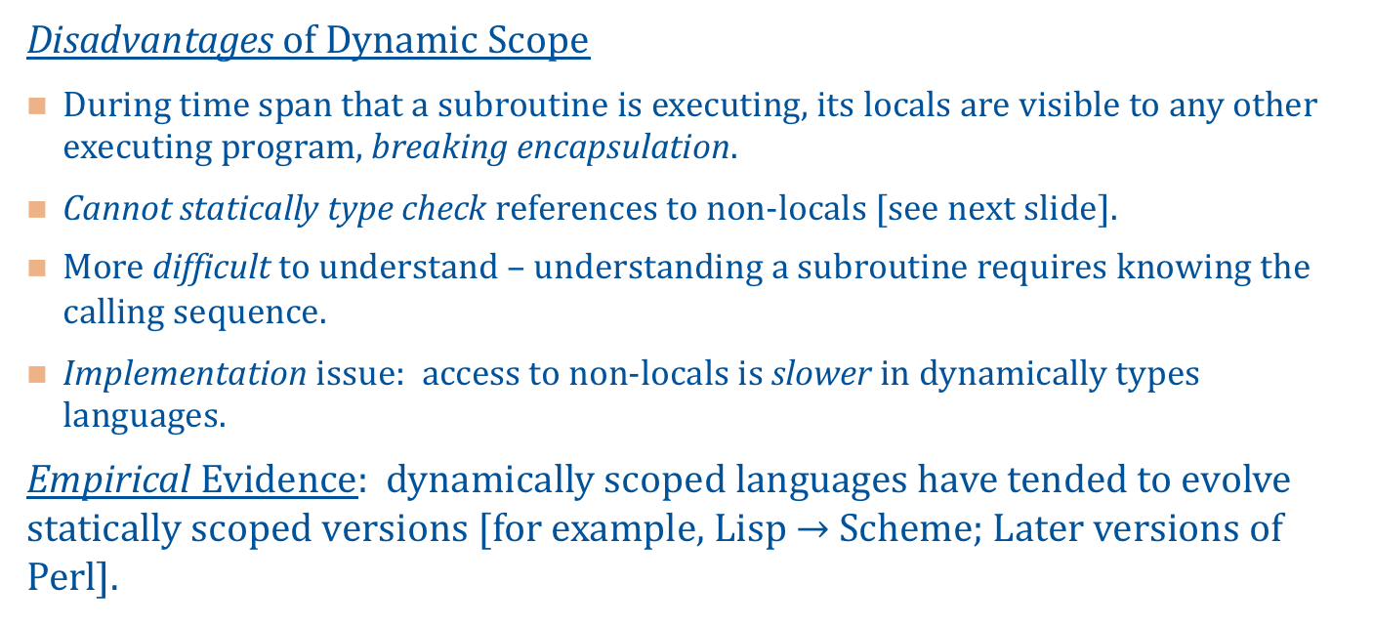
Static Scope Trending…
Disadvantages of Dynamic Scope
During time span that a subroutine is executing, its locals are visible to any other executing program, breaking encapsulation.
Cannot statically type check references to non-locals [see next slide].
More difficult to understand – understanding a subroutine requires knowing the calling sequence.
Implementation issue: access to non-locals is slower in dynamically types languages.
Empirical Evidence: dynamically scoped languages have tended to evolve statically scoped versions [for example, Lisp $→$ Scheme; Later versions of Perl].

Slide 74
Which is it?
x: integer;
procedure sub1 { printint x; }
procedure sub2 {
x: boolean;
x = true;
call sub1;
}
read x;
if ( x > 0 ) call sub1 else call sub2;
Is this type safe?
Cannot tell until runtime.

Slide 75
Implementing Scope
We have talked about what the scope rules are.
Now, consider how to implement these rules in the compiler and run-time system.
We have discussed how local variables can be found at runtime, but not how the compiler manages this setup.

Slide 76
Implementing Static Scope in a Compiler
Use a data structure called a symbol table which contains (name, attribute) pairs.
Attributes include the various things that the compiler needs to know about the name:
Type
Address or offset
Value if a constant
and so on…

Slide 77
Implementing Static Scope in a Compiler
Basic operations provided by the symbol table:
create an empty symbol table
insert an entry [associates identifiers with attributes]
lookup an entry [returning attributes associated with a given identifier]
delete an entry
The organization of the symbol table depends on the structure of the language.

Slide 78
Example: Monolithic Block Structure
The only block is the entire program.
Use a HashTable.
insert entries when variables declared
lookup entries when variables are referenced
Name | Attributes
x | int, …
y | bool, …

Slide 79
Example: Flat Block Structure
Two scope levels.
Global – names visible everywhere
Local – visibility restricted to declaration block
When a variable is encountered in an expression, it must be matched with the appropriate declaration.
Symbol table changes during compilation.

Slide 80
Program A {
int x;
procedure B {
int y;
// …
x = y;
}
procedure main {
boolean y;
int z;
// …
if ( !y ) then x = z + 1;
// …
}
}
Symbol Table when analyzing B
Identifier | Level | Attributes
x | global | int, …
y | local | int, …

Slide 81
Program A {
int x;
procedure B {
int y;
// …
x = y;
}
procedure main {
boolean y;
int z;
// …
if ( !y ) then x = z + 1;
// …
}
}
Symbol Table when analyzing main
Identifier | Level | Attributes
x | global | int, …
y | local | bool, …
z | local | int, …

Slide 82
Modifications to Simple Interface
Add enterScope() and leaveScope() methods to SymbolTable.
enterScope(): called at the start of the block
leaveScope(): called at the end of the block
After a scope is entered, new declarations are local to that scope.
The most obvious data structure is a stack.

Slide 83
Nested Block Structure
Blocks may be nested within one another.
There may be many scope levels [not just global and local].
class X {
int x;
void f() {
int y; int z; // …
while ( x != 0 ) { int x = y + z; }
}
}

Slide 84
Nested Block Structure
Declarations at the outermost level are global in scope [first level, level 0].
Declarations inside an inner block are local to that block.
Every inner block is completely contained by another block.
The level of the block is the level of the enclosing block +1.
Record level numbers in the level field in the symbol table.

Slide 85
Nested Block Structure
The symbol table keeps track of the current scope level.
At the start of a block, enterScope is called – incrementing the scope level.
At the end of a block, leaveScope is called:
Decrementing the current scope level.
Removing entries with higher scope level.
When an entry for identifier i is requested, the matching entry for i with the highest scope level will be returned.

Slide 86
Symbol Table Implementation
A Few Observations…
In serious compilers, efficiency is important.
Identifier lookup is a frequent operation, adding a new entry is infrequent. Stack implementation has fast add, but slow lookup.
To support debuggers, symbol table information should be maintained [not popped and discarded] even when no longer needed by the compiler.
Naïve Implementation
Use a stack.
Linear search from the top of the stack.
Return first match found.
Pop entries when leaving scope.

Slide 87
Leblanc-Cook Symbol Table
More efficient than a stack. Main Idea:
Each scope is assigned a unique serial number.
New scopes given a new number as they are encountered [these numbers do not reflect nesting].
All identifiers are entered into one hash table with their attributes and scope number.
The hast table chains entries with the same identifier.
A separate scope stack records the scopes that belong to the current referencing environment.

Slide 88
int current_scope, next_scope;
void enterScope() {
current_scope = next_scope++;
scope_stack.push( current_scope );
}
void closeScope() {
current_scope = scope_stack.pop();
}
void lookup( String name ) {
// gets matching entry in hash table;
// scan chain and return attributes for entry
// with scope number closest to the top of the scope stack;
}

Slide 89
Example
class X {
int x;
void f() {
int y; int z; // …
while ( x != 0 ) { int x = y + z; }
print(x); // added statement
}
}

Slide 90
Example
Identifier | Scope | Attributes
X | 0 | program
x | 1 | int, …
f | 1 | Method, void…
class X {
int x;
void f() {
int y; int z; // …
while ( x != 0 ) { int x = y + z; }
print(x);
}
}
Current Level
0

Slide 91
Example
Identifier | Scope | Attributes
X | 0 | program
x | 1 | int, …
f | 1 | Method, void…
class X {
int x;
void f() {
int y; int z; // …
while ( x != 0 ) { int x = y + z; }
print(x);
}
}
Current Level
1
0

Slide 92
Example
Identifier | Scope | Attributes
X | 0 | program
x | 1 | int, …
f | 1 | Method, void…
y | 2 | int, …
z | 2 | int, …
class X {
int x;
void f() {
int y; int z; // …
while ( x != 0 ) { int x = y + z; }
print(x);
}
}
Current Level
2
1
0

Slide 93
Example
Identifier | Scope | Attributes
X | 0 | program
x | 1 | int, …
f | 1 | Method, void…
y | 2 | int, …
z | 2 | int, …
class X {
int x;
void f() {
int y; int z; // …
while ( x != 0 ) { int x = y + z; }
print(x);
}
}
Current Level
3
2
1
0

Slide 94
Example
Identifier | Scope | Attributes
X | 0 | program
f | 1 | Method, void…
y | 2 | int, …
z | 2 | int, …
Identifier | Scope | Attributes
x | 1 | int, …
class X {
int x;
void f() {
int y; int z; // …
while ( x != 0 ) { int x = y + z; }
print(x);
}
}
Current Level
3
2
1
0

Slide 95
Example
Identifier | Scope | Attributes
X | 0 | program
x | 3 | int, …
f | 1 | Method, void…
y | 2 | int, …
z | 2 | int, …
Identifier | Scope | Attributes
x | 1 | int, …
class X {
int x;
void f() {
int y; int z; // …
while ( x != 0 ) { int x = y + z; }
print(x);
}
}
Current Level
3
2
1
0

Slide 96
Example
Identifier | Scope | Attributes
X | 0 | program
x | 3 | int, …
f | 1 | Method, void…
y | 2 | int, …
z | 2 | int, …
Identifier | Scope | Attributes
x | 1 | int, …
class X {
int x;
void f() {
int y; int z; // …
while ( x != 0 ) { int x = y + z; }
print(x);
}
}
Current Level
2
1
0

Slide 97
Example
Identifier | Scope | Attributes
X | 0 | program
x | 3 | int, …
f | 1 | Method, void…
y | 2 | int, …
z | 2 | int, …
Identifier | Scope | Attributes
x | 1 | int, …
???
class X {
int x;
void f() {
int y; int z; // …
while ( x != 0 ) { int x = y + z; }
print(x);
}
}
Current Level
2
1
0

Slide 98
Example
Identifier | Scope | Attributes
X | 0 | program
x | 1 | int, …
f | 1 | Method, void…
y | 2 | int, …
z | 2 | int, …
Identifier | Scope | Attributes
class X {
int x;
void f() {
int y; int z; // …
while ( x != 0 ) { int x = y + z; }
print(x);
}
}
Current Level
2
1
0

